Slide 1
Short Run Decision Analysis

Slide 2
Introduction
Short-run Decisions
Product-pricing
Product-mix
Make or buy
Long-run Decisions
Setting up a new plant

Slide 3
Steps in Decision-Making
Identification of the problem
Collection of information
Making future projections
Choice among alternatives

Slide 4
Introduction
In this chapter, we discuss the tools that managers use to make the short-term tactical decisions.
In particular, we focus on relevant costs, which are costs that differ among alternatives—that is, costs that are avoidable or can be eliminated by choosing one alternative over another.

Slide 5
Relevant Costs
Almost all the costs are fixed with respect to the number of passengers on the plane. Therefore, the only relevant costs that would change between alternatives are the variable cost of food and drinks.

Slide 6
Opportunity Costs
When one course of action is chosen than the other, the possible benefit lost from the rejected alternative is the opportunity cost of the alternative accepted.
Eg: A company having surplus storage place can either use it for storing its own products or rent it out. The opportunity cost of using the space is the rental revenue that will be foregone due to such use.

Slide 7
Sunk Cost
These are irrelevant to decision making because these are unavoidable and cannot be changed.

Slide 8
Discretionary Cost
These costs are the result of management discretion and policy, the amount of these costs are periodically decided by the management.
Eg: R&D, Advertising, Training etc.

Slide 9
Incremental Cost
These cost are the additional cost resulting from the decision.
Eg: Make or Buy decision

Slide 10
Decision Situation
Sales Volume related Decision
Other short run decision
Acceptance of one time only special orders
Product mix decisions under capacity constraint
Decisions to sell or process further
Outsourcing and other make or buy decisions

Slide 11

Special Orders
Deciding whether to accept a special order is a short-run decision. Management must decide:
What sales price is appropriate for one-time customers?
Does the company have excess capacity?
Can it produce additional units with its existing resources?

Slide 12
Excess Capacity
Special orders are almost never accepted if a company does not have excess capacity, because current customers may have to be turned away.
Excess Capacity
Even when excess capacity exists and a special order is profitable, companies must consider qualitative factors.
Excess Capacity

Slide 13
Special Order - Example
Imagine that Sunset Airlines, a major regional airlines, has been asked by a large corporation to provide 150 seats to executives attending a conference.
The corporation offers Rs.6,250 per ticket.
The normal fare is Rs.13,750.
The ticket is only good for one day for any of 5 flights.
The aircraft carries 180 passengers ( or 5 x 180 = 900 for one day).
The normal load is 700 per day.
Sunset Airlines
Since Sunset has
excess capacity, should they accept the special order?

Slide 14
Special Order - Example
What are the OPTIONS?
Sell the special order tickets at Rs.6,250
Sell only the Rs.13,750 market price tickets.
Sell the special order tickets at another price.
Sunset Airlines

Slide 15
Excess Capacity Makes a Difference
In situations where excess capacity exists, the general rule is that the special order price must simply be higher than the additional variable costs incurred in accepting the special order, if excess capacity exists.

Slide 16
Excess Capacity Makes a Difference
If there is no excess capacity, Sunset will have to forgo the receipt of Rs.13,425 of contribution margin on each ticket Rs.13,750-Rs.325). By turning away full-pay customers, they will lose Rs.7,500. Therefore, they should not accept a special order for less than
Rs.13,750 per passenger.

Slide 17
Outsourcing and Other Make-or-Buy Decisions
The Decision to Outsource
Requires and in-depth analysis of relevant quantitative and qualitative factors, as well as costs and benefits and vertical integration
Affects a wide range of organizations.

Slide 18
Resource Utilization Decisions
A resource utilization decision requires an analysis of how best to use a resource that is available in limited supply.
For Example:
Limited Resource in a Grocery Store?
Which Products should be carried?
Shelf-Space is Limited.
How many of each?

Slide 19
Resource Utilization Decisions
Resource utilization decisions are typically short-term decisions.
Short-Run: Resources like machine time, labor hours, and shelf space are fixed and cannot be increased.
Long-Run: New machines can be purchased, more skilled laborers can be hired, and stores can be expanded.
Short-run constraints mean a focus on the contribution margin of each product per unit of limited resource rather than profitability of each product.

Slide 20
Scarce or Limited Resources
Assume Birdie Maker’s limited resource is machine time when making golf balls. They produce 1 carton of the Pro Model in 30 minutes and 1 carton of the Tour Model in 45 minutes.
If demand is not a factor, which model maximizes profit if machine time is limited to 300 hours?
Birdie Maker

Slide 21
The Resource Utilization Decision
Contribution margin per carton is the same for both the Pro Model and the Tour Model. However, the contribution margin per unit of limited resource results in each carton of Pro Model balls with a contribution margin of Rs.15,000 per hour of machine time, as compared to Tour Model balls at Rs.10,000per hour of machine time.
Birdie will maximize profit by selling only the Pro Model.

Slide 22
Optimal Product Mix
If demand for either model is limited, the company must decide on the optimal mix.
Assume demand is 400 cartons of Pro Model and 150 cartons of Tour Model.
Looking at the most profitable item per constraint, the capacity of Pro is 300 hours ÷ 0.5 hours = 600 cartons.
However, since Birdie can only sell 400 cartons, the optimal mix is 400 cartons of Pro (using 200 hours) and 133 cartons of Tour (100 hrs. ÷ 0.75 hrs.) using the remaining 100 hours.

Slide 23
Qualitative Issues and Other Options
Qualitative issues include:
Is the visibility of the Tour ball on the professional tour a valuable source of advertising?
Does it contribute to sales of the Pro Model?
Loosening the Constraints:
Add machines to increase the amount of available machine hours.
Reduce the amount of machine time it takes to make a carton of balls.

Slide 24
Sell or Process Further
Sell or Process Further
Relevant Costs
Decision
Question
Additional Revenue > Additional Costs, then Process Further
If not, sell as is.
Common management decision
In today’s business environment, companies have to be aware not only of the economic impact of their decisions, but also of their ethical impact.
Incremental or Additional Processing Costs
Information being used for?
Good Ends?
Bad Ends?
To exceed government limits??
To ignore product safety??
To falsify records??

Slide 25
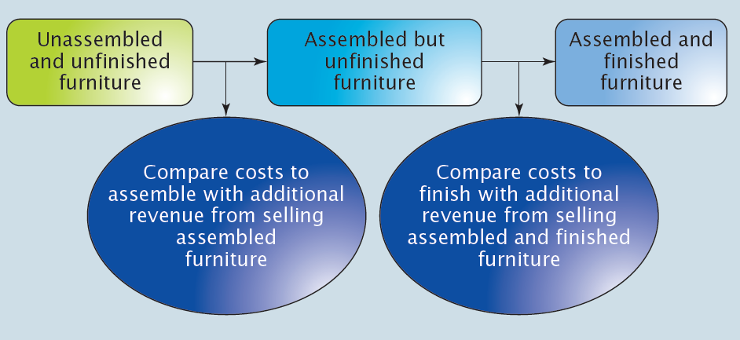
Sell or Process Further
Let’s look at a furniture manufacturer that can sell furniture unassembled and unfinished, assembled and unfinished, or assembled and finished.

Slide 26
Sell or Process Further
Assume unassembled and unfinished tables cost Rs.5,000 to produce
and can be sold for Rs.7,500. The company is considering selling assembled and finished tables for Rs.11,250 each. Additional assembly and finishing costs of Rs.2,250 per table would be required.
Process further for a Rs.1,500per table profit!
Incremental revenue = Rs.3,750
As long as the extra costs are less than Rs.3,750, the company will maximize profits by further processing.
Not relevant – sunk cost

Slide 27
Vertical Integration
The value chain of an organization is simply the set of activities that increase the value of an organization’s products and services. Vertical integration is accomplished when a company is involved in multiple steps of the value chain, extending from R&D to Customer Service.
Production
Upstream
Costs
Marketing
Product Development
Downstream
Costs
Distribution
Research & Development
Customer Service

Slide 28
Vertical Integration
Most companies operate with some form of vertical integration (they market the products they produce, or they develop the products they manufacture), but
the extent of integration varies greatly from company to company and from product to product within a company.
Production
Upstream
Costs
Marketing
Product Development
Downstream
Costs
Distribution
Research & Development
Customer Service

Slide 29
Vertical Integration
Advantages: Not dependent on timely delivery and can control quality
Disadvantages: Suppliers may supply higher-quality items at less cost

Slide 30
The Decision to Drop a Product or Service
The decision to drop a product or a service is among the most difficult that a manager can make.
Qualitative factors are sometimes more
important than focusing solely on income.

Slide 31
Dropping a Product or Service
Clayton Herring is thinking about dropping the mud and snow (M&S) tyres. They require more machine time to make than the other tyres. Only Rs.100,000 of M&S’s fixed costs are avoidable. Should they drop the line?
Clayton Herring
Tire
Company

Slide 32
The Decision to Drop a Product
The Rs.250,000 of the fixed costs allocated to mud and snow tires would have to be reallocated to other product lines, because these costs remain even if the mud and snow tires are discontinued. If the company drops the line, it will lose money because the contribution margin decreases by Rs.325,000, whereas fixed costs decrease by only Rs.100,000 if the tires are dropped.

Slide 33
Target Costing
Target costing is an approach to costing which identifies an estimated price customers are willing to pay and then compute a target cost to earn the desired profit. Target price, calculated, using the information from customers and competitors forms the basis for calculating the target cost.

